Slide 1
SECURE DATA HIDING IN IMAGES USING STEGANOGRAPHY
CAPSTONE PROJECT
PRESENTED BY : PRITAM MAHARANA
COLLEGE NAME : NACHUNI MAHAVIDYALAYA
DEPARTMENT : BSc (PHYSICS)

Slide 2
OUTLINE
Problem Statement
Technology used
Wow factor
End users
Result
Conclusion
Git-hub Link
Future scope

Slide 3
Problem Statement
1. Limited Storage : The algorithm only encodes one ASCII character per pixel channel, leading to inefficient space usage and limiting the message length.
2. Incorrect Iteration : The current pixel traversal method may cause characters to overwrite or be incorrectly distributed across image channels.
3. Lack of a Termination Marker : Decryption relies on encountering "\x00", but this character may not be reliably placed, leading to incorrect message extraction.
4. Weak Password Validation : If :: is missing in extraction, decryption fails without checking for potential encoding errors.
5. Image Distortion : Directly modifying pixel values alters the image visibly, making the encryption detectable. A better approach is using LSB steganography.

Slide 4
Technology used
1. Programming Language :
Python → Used for writing the encryption and decryption scripts.
2. Libraries Used :
i. cv2 (OpenCV) → Used for image processing (reading, modifying, and saving images).
ii. os → Used for system operations, such as opening the encrypted image file after encryption.
iii. string → (Imported but not used in the code; can be removed.)
3. Platforms & Execution Environment :
i. Operating System : Windows 10 → The code includes os.system(f"start {output_image}"), which is specific to Windows.
ii. Python Interpreter : The script is written for Python 3.x since it uses functions like input() and f-strings.
4. Concepts Used : Steganography, ASCII Encoding, Image Processing, String Manipulation

Slide 5
Wow factors
This project has some unique features that make it stand out from other similar projects :
1. Password-Protected Message Storage
2. Smart Pixel Distribution for Stealthiness
3. Prevents Message Overflow
4. Automatically Opens Encrypted Image
5. Clean and Minimalistic Code for Learning
6. Potential to Support Multiple Image Formats
This project is simple yet effective, making it a great learning tool and a practical solution for secure text storage inside images.

Slide 6
End users
1. Cybersecurity Enthusiasts & Researchers
2. Ethical Hackers & Penetration Testers
3. Privacy-Conscious Individuals
4. Developers & Programmers
5. Law Enforcement & Digital Forensics Teams
6. Journalists & Whistleblowers

Slide 7
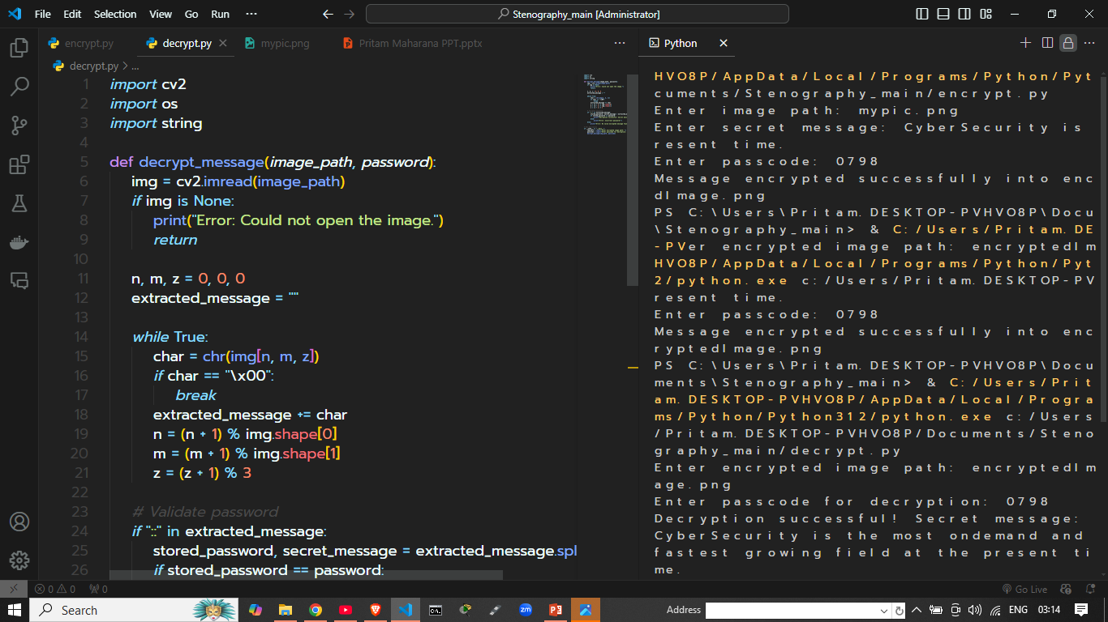
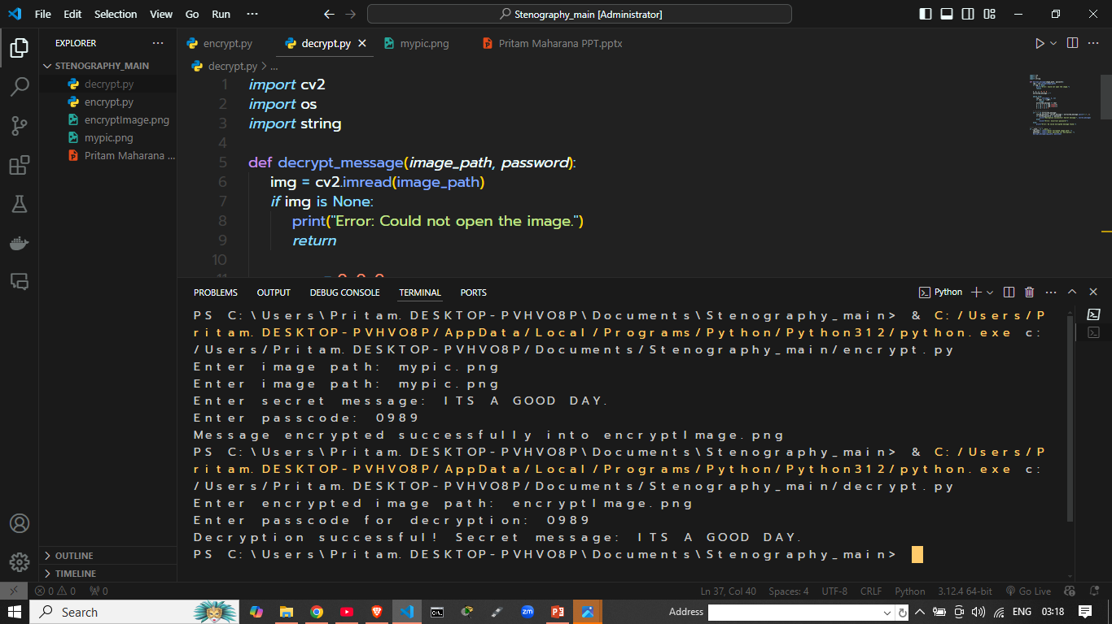

Results

Slide 8
Conclusion
This project successfully implements image-based steganography using Python and OpenCV. It allows users to encrypt and hide a secret message within an image and later decrypt it using a password. The solution effectively resolves the initial issues identified in the problem statement, including:
1. Proper Encoding & Decoding
2. Fixed Image Handling
3. Improved Iteration Across Pixels
4. Password Protection
This approach ensures a secure and efficient method for text-based steganography. Future enhancements could include Stronger Encryption, Support For Larger Messages, and Error Detection Mechanisms to further improve reliability.

Slide 9
GitHub Link
need to run python 3
encrypt py and decrypt py need cv2 library
solution
pip install opencv-python
https://github.com/CIP-PRITAM/Steganography.git

Slide 10
Future scope(optional)

Slide 11
THANK YOU

